Slide 1
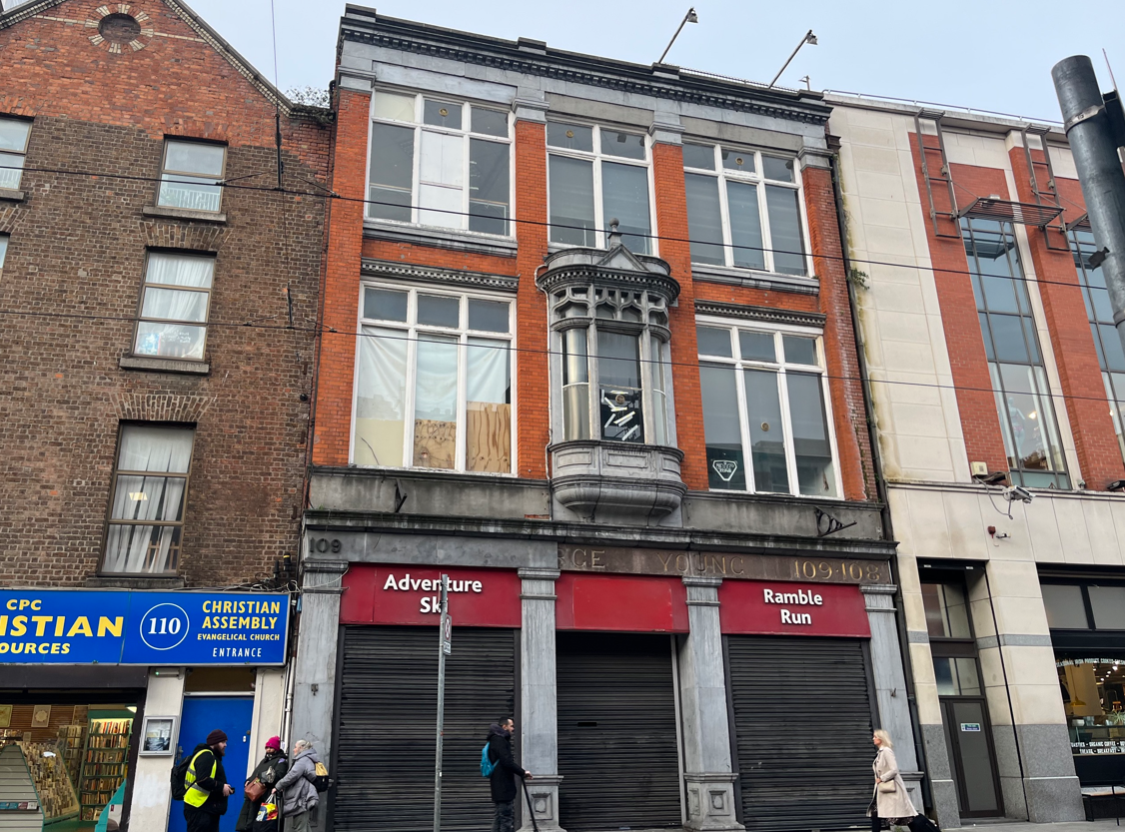
Freehold Opportunity: For Sale by Private Treaty
108-109 Middle Abbey Street, Dublin 1.
Property Highlights
Contact
Excellent opportunity to acquire a commercial unit located in a prominent position on Middle Abbey Street.
Middle Abbey Street is centrally located in Dublin’s City Centre characterised by its commercial vibrancy and convenient transportation links.
The subject property is a mid terraced three storey over basement building.
Extending to a total floor area of approx. 702 sq m (7,556 sq ft )
Seeking offers in excess of €900,000.
Peter Love
Email: Peter.Love@cushwake.com
Tel: +353 1 639 9612
Niall Kellegher
Email: Niall.Kellegher@cushwake.com
Tel:+353 1 639 9683
Cushman & Wakefield
164 Shelbourne Road
Ballsbridge,
Dublin 4
Ireland
Tel: +353 (0)1 639 9300
Property Description
108-109 Middle Abbey Street comprises a distinctive three storey building over a concealed basement.
The unit is currently in vacant possession and was formerly occupied by Base Camp. The fit out has since been removed.
Extending to a total floor area of 702 sq m (7,556 sq ft.). The first floor boasts an expansive layout, complete with a mezzanine area suitable for a variety of uses.
The unit currently has planning permission for restaurant use.
cushmanwakfield.ie
cushmanwakfield.ie

Slide 2
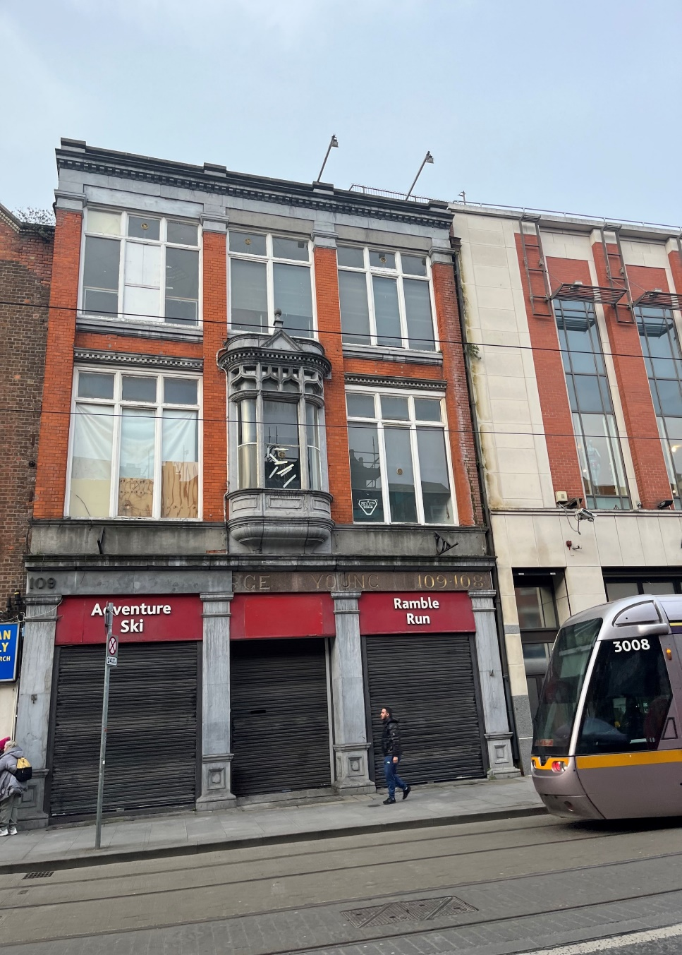
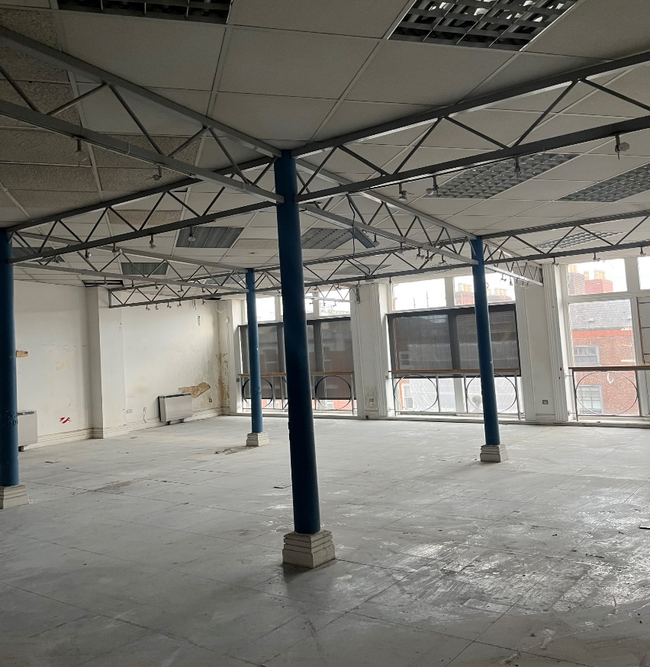
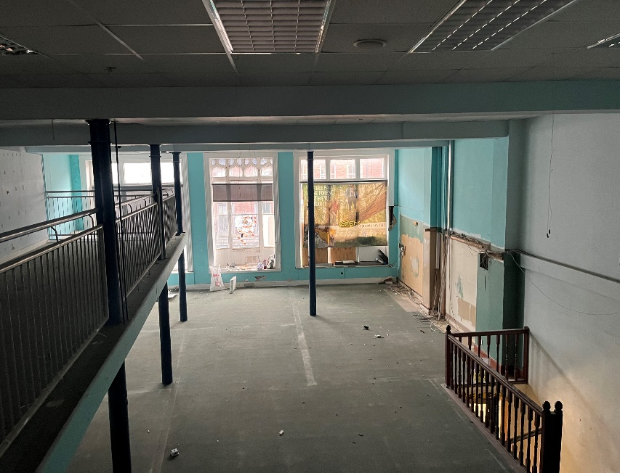
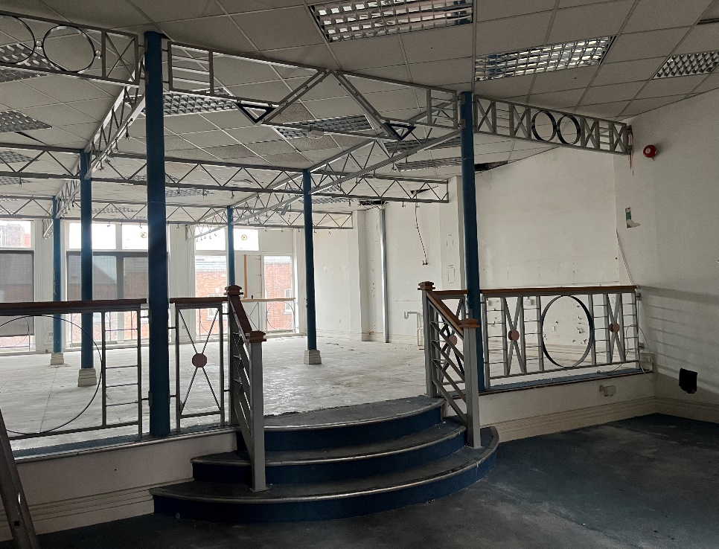
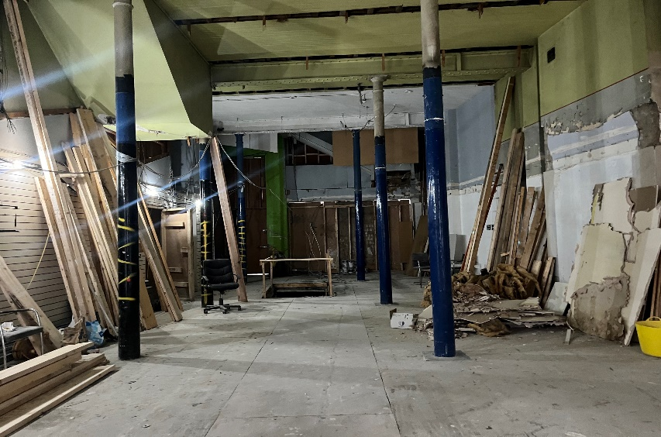
Freehold Opportunity: For Sale by Private Treaty
108-109 Middle Abbey Street, Dublin 1.
cushmanwakfield.ie
cushmanwakfield.ie

Slide 3
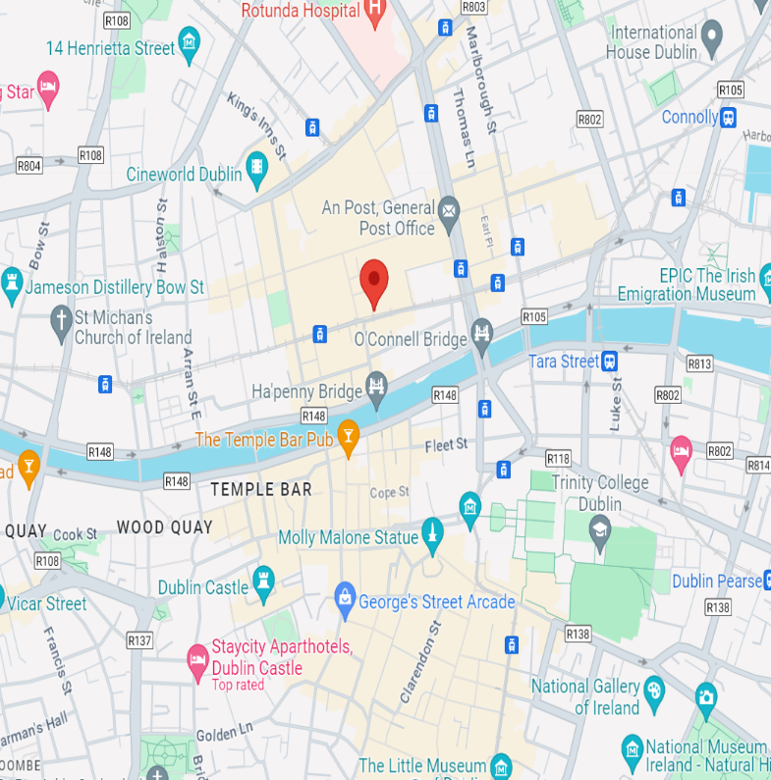
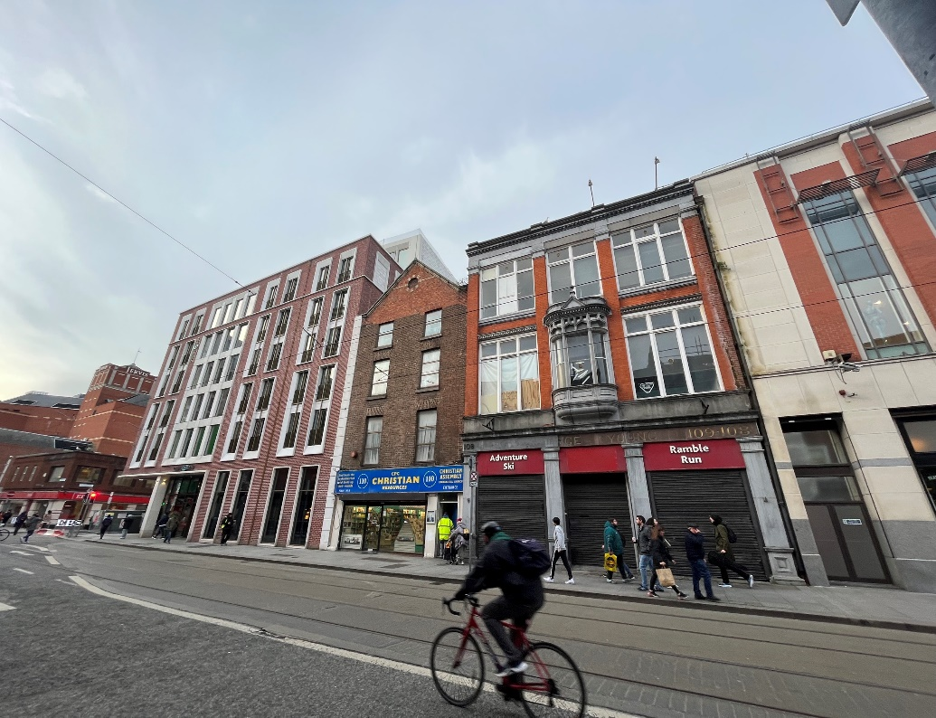
Location
Schedule of Accommodation
The property is situated on Middle Abbey Street, centrally located in Dublin City Centre. It runs parallel to O’Connell Street one of the cities main throughfares and is surrounded by other prominent streets including Henry Street and Capel Street. The Street is part of a bustling commercial district lined with stores, restaurants, cafes and entertainment venues. Neighboring occupiers include Arnott's department store, Hotel Motel One, Penney's, CEF, WIG WAM and The Academy.
Middle Abbey Street benefits from a comprehensive network of transport links, including buses, trams, walking and cycling infrastructure, taxis and rail connections. The Luas offers a convenient and efficient way to travel within Dublin’s City Centre and surrounding areas. The Jervis stop on the Luas Red Line and the O’Connell Street stop on the Luas Green Line are both located nearby, providing easy access to the tram system for commuters. The Streets proximity to rail services such as Connolly and Tara Street Station further enhance the areas accessibility.
Floor | Sq M | Sq Ft
Basement | 166 | 1,786
Ground Floor | 166 | 1,786
First Floor | 166 | 1,786
First Floor Mezz | 38 | 409
Second Floor | 166 | 1,786
Total Floor Area | 702 | 7,556
Any intended purchaser will need to satisfy themselves as to the exact area of the subject property
.
Viewings
Guide Price:
Seeking offers in excess of €900,000.
Strictly by appointment through sole selling agent
BER Details:
BER No. 800968786
Commercial Rates
2024 commercial rates payable were approximately €20,744.94
A full copy of our general brochure conditions can be viewed on our website or can be requested from your local Cushman Wakefield office. We strongly recommend that you familiarise yourself with these general conditions. While care has been taken to ensure that information contained in Cushman Wakefield publications is correct at the time of publication, changes in circumstances after the time of publication may impact on the accuracy of this information. PSRA Registration Number: 002222. Subject to Contract/Contract Denied.

